Slide 1
Map reduce examples

Slide 2
Map Reduce Concept
It performance the processing of large data sets in distributed and parallel manner
MapReduce consist of two distinct tasks – Map and Reduce.
It works on divide and conquer approach: and convert data into key value pair and it combines intermediate result into final result
Two essential daemons of MapReduce Job Tracker and task Tracker
Job tracker: process schedule and provide resources, monitoring it is like an operating system .
Task Tracker:

Slide 3
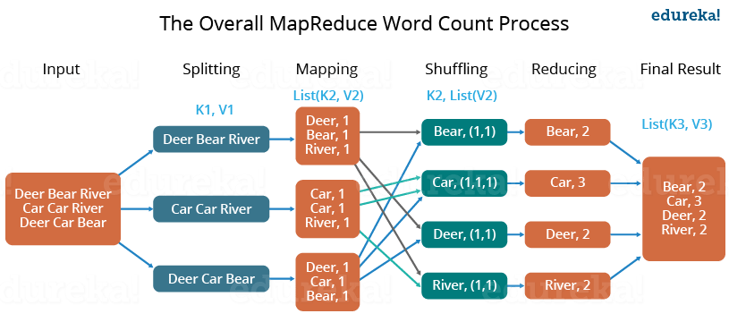

Slide 4
To run wordcout program in hive
Open terminal
>ls
# to know the present working directory
>pwd
Create a file where we have write something
>cat > /home/cloudera/file.txt
Write something
>To save
Press Ctl+z
#check file is created successfully
> -ls cat > /home/cloudera/file.txt

Slide 5
Contd..
# move this to hdfs
>hdfs dfs –ls /
#create a folder
>hdfs dfs –mkdir /inputfolder
# now move file into hadoop file system
>hdfs dfs –put /home/cloudera/file.txt /inputfolder/
#check file is moved successfully
>hdfs dfs –cat /inputfolder/file.txt
#Run file in file
> haddop jar /home/cloudera/WordCount-jar WordCount /inputfolder/file.txt /out1
#here out1 we have used to store the file
To check where file is saved
>hdfs dfs –ls /out1
>-hdfs dfs –cat /output1-r-00000

